Slide 1

IS3S661 Strategic IS Management
Strategy Formulation:
Business Intelligence & Demographics
David Kidner (J302) david.kidner@southwales.ac.uk

Slide 2
Last Week …
Capability Analysis …
Value is in “the eye of the beholder”
Value Creation
Value Chain Model
Helps identify Cost Structures & Core Competences
Resource Analysis
VRIN
Core Competencies

Slide 3
Last Week …
Resources
Inputs into a firm’s production process, e.g.
Capital equipment
Skills of individual employees
Patents
Finances
Talented managers
Capabilities
Capacity of a set of resources to perform in an integrative manner
A capability should not be
So simple that it is highly imitable
So complex that it defies internal steering and control
When the four key criteria of resources and capabilities (VRIN) are met, they become core competencies
Core competencies serve as a source of competitive advantage

Slide 4
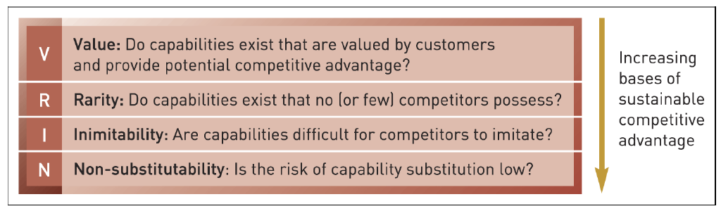
Last Week …VRIN

Slide 5
Resources & Capabilities …
Valuable
Core Competencies
Rare
Competitive Advantage
Inimitability
Costly to Imitate
Value Creation
Non-Substitutable
Above Average Returns

Slide 6
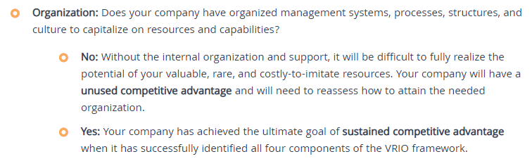
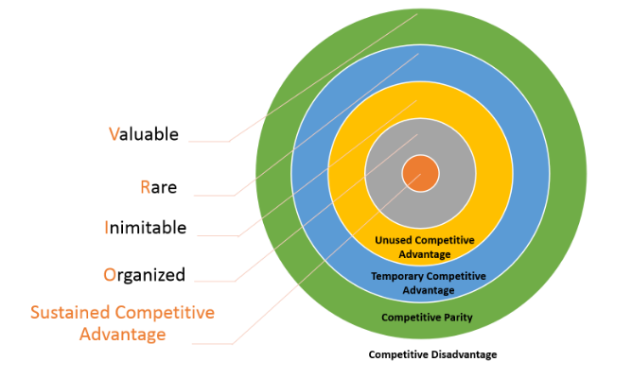
VRIO Framework
Focus is on Organisational Capabilities

Slide 7
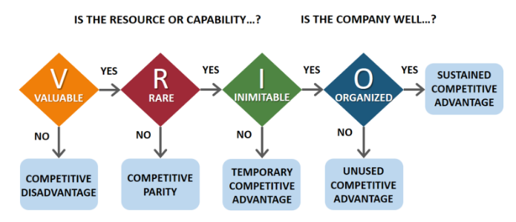
VRIO Framework

Slide 8
VRIN or VRIO
Organisational factors are easier to qualify or quantify
For your coursework, it’s up to you which you use.
Look at some case study examples …

Slide 9
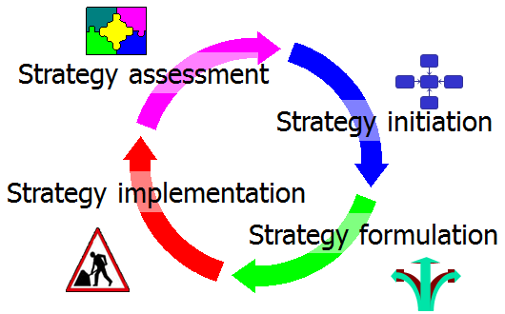
Strategy Formulation
The development of strategies to exploit opportunities and manage threats in the business environment in light of corporate strengths and weaknesses.
In this phase, managers build awareness and make plans to create new customer value
Be conscious of own abilities and limitations
Develop clear vision of what the customer needs are and what the customer is looking for
Moves from Capability Evaluation to Knowledge Building and e-Business Design

Slide 10
Strategy Formulation
Having analysed our organisation’s abilities and the external forces, we now need to answer these important questions:
What will you sell?
Who will you sell it to?
What will you charge?
How will you promote it?
How will you sell it?
Understanding
Customers:
Demographics
Marketing
Next Week
What factors will affect all these decisions?

Slide 11
Strategy Formulation
What factors will affect all these decisions?
Your financial stability:
may force you to take low-cost options.
Your market strength and expertise:
you may be able to dictate what will be sold and how.
Your existing business:
your existing profitable work may be harmed by e-Commerce.
Your distribution network:
they may want to share in on-line sales.
Your product/service’s applicability:
may have specialised appeal to a market segment or nation.

Slide 12
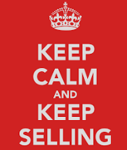
What Will You Sell?
Low risk or high risk, low value.
Brand names, standard spec. or customers can “play” with the spec.
Wide product variety.
Products that are easy to dispatch.
Digital products.
Services where the customer’s presence is not required.
High demand (either nationwide or many regular customers in a given locality).
Suitable for use in many countries.
Iterative with your capability analysis

Slide 13
Who Will You Sell it To? B2C Buyers
Time-Starved Consumers.
E.g. two-income homes, prepared to pay extra.
Shopping Avoiders.
Use e-Commerce to avoid queues, traffic.
New Technologists.
Like e-Commerce “because it’s cool”.
(Turban et al, Electronic Commerce: A Managerial Perspective. International ed. Prentice Hall)

Slide 14
Who Will You Sell it To? B2C Buyers
Time Sensitive Materialists.
Use clicks-and-mortar e-Commerce sites only to find prices, then buy from shop.
Hunter Gatherers.
Enjoy price comparisons and search for value.
Brand Loyalists.
Shop solely for specific brands.
Single Shoppers.
(Turban et al, Electronic Commerce: A Managerial Perspective. International ed. Prentice Hall)

Slide 15
Who Will You Sell it To? B2C Buyers
What categories are missing from the Turban list? What is the significance?
The housebound? Physically disabled? Shift workers? Remote locations?
Identify potential new markets.
Why is it important to identify categories of buyers who currently use e-Commerce?
Existing markets. Growth potential.
Need to understand Customer Behaviour …

Slide 16
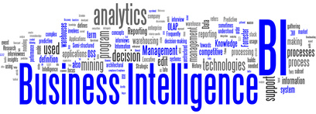
Skills, knowledge, technologies, applications, quality, risks, security issues and practices used to help a business to acquire a better understanding of market behaviour and commercial context.
For this purpose it undertakes the collection, integration, analysis, interpretation and presentation of business information.
By extension, "business intelligence" may refer to the collected information itself or the explicit knowledge developed from the information.
Can be applied throughout the organisation, not just understanding customers and demographics.

Slide 17
Business Intelligence or Business Analytics?
Business Intelligence and Business Analytics are sometimes used interchangeably, but there are alternate definitions.
One definition contrasts the two, stating that the term business intelligence refers to collecting business data to find information primarily through asking questions, reporting, and online analytical processes. Business analytics, on the other hand, uses statistical and quantitative tools for explanatory and predictive modelling.

Slide 18
BI – Understanding Customers
Enables managers to understand priorities by gathering information on how customer needs change over time
Strategy must be based on fact, not opinions
Otherwise, right strategy for wrong problem

Slide 19
E-Commerce Consumer Behaviour
Individual
Characteristics
Age, gender, ethnicity,
education, lifestyle,
psychological, knowledge,
values, personality
Environment
Characteristics
Social,
Family,
Communities,
Fashions
Stimuli
Buyers’ Decisions
Marketing
Price
Promotion
Product
Quality
Others
Economical
Technology
Political
Cultural
Decision
Making
Process
Buy or not?
What to buy?
Where (vendor)?
When?
How much to spend?
Repeat purchases?
Vendors’ Systems
Logistic
Support
Payments,
Delivery
Technical
Support
Web design,
Intelligent-
agents
Customer
Service
FAQ, e-mail,
Call Centres,
One-to-one,
Social Media
Adapted from Turban, 2002

Slide 20
Demographics
Studies of a population based on factors such as age, race, sex, economic status, level of education, income level and employment, among others. Demographics are used by governments, corporations, NGOs and businesses to learn more about a population's characteristics for many purposes, including policy development and economic market research.
Demographic trends are also important, as the size of different demographic groups will change over time as a result of economic, cultural and political circumstances.
Segmenting a population into demographics allows companies to assess the size of a potential market and also to see whether its products and services are reaching that company's most important consumers.

Slide 21
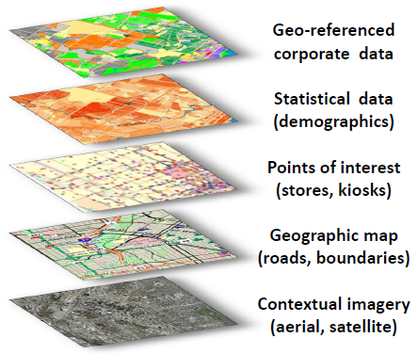
Location Intelligence
Convergence of BI with Location Intelligence
80% of Business Data has a Location Component
Most businesses can benefit from utilising location in decision making.
Organisations that:
Market by Location
Plan by Location
Assign Assets by Location
Track Resources by Location
Manage Services by Location

Slide 22
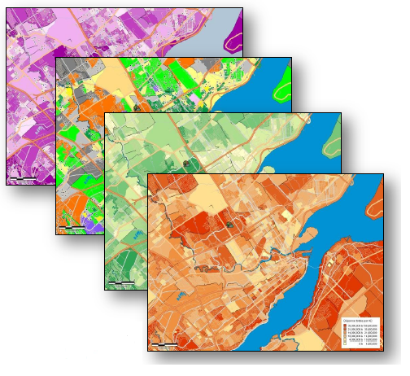
Location Intelligence
Location Prospecting
Identifying MORE CUSTOMERS similar to your best customer profile means potential increase in profits
Competitive Market Analysis
Precise Target Marketing
Combine customer data with demographic data (e.g. Census data) and free public datasets.
Adds Value to existing data.

Slide 23
Hypothetical Example: Amazon
Customer 1 (CF37 1DL)
Postcode = Ward Treforest
Census & Other Data
Unemployment=10%, Students=25%, OAPs=15%, Children=10%, Car Owners=20%,
Crime Data, Deprivation Data, Schools Data, House Price Data, etc.
Targeted Products
Game: FIFA 20
Music: Justin Timberlake or Bieber / MP3 Download
Book: James Patterson “Hope to Die”
Electronics: Amazon Fire TV
Home Appliances: Tin Opener
Clothes: Kappa Tracksuit
Toy: Disney Frozen Sing-A-Long Elsa
Customer 2 (CF15 8BN)
Postcode = Ward Radyr
Census & Other Data
Unemployment=5%, Students=5%, OAPs=25%, Children=15%, Car Owners=50%
Crime Data, Deprivation Data, Schools Data, House Price Data, etc.
Targeted Products
Game: Deluxe Chess
Music: Andrea Bocelli “Cinema” / CD
Book: Simply Nigella “Feel Good Food”
Electronics: LG Smart 4K UHD 98 Inch TV
Home Appliances: Robomow (Robotic) Lawnmower
Clothes: Armani Suit
Toy: DJI Phantom 4 Professional (Drone)
Stereotyping!

Slide 24
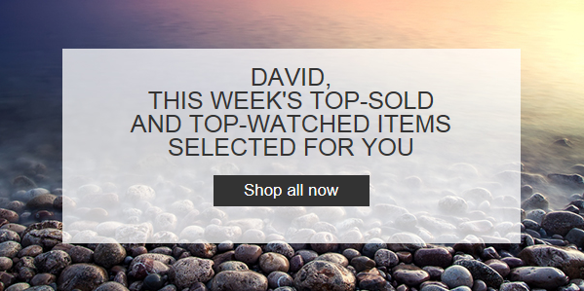
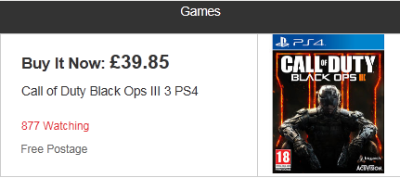
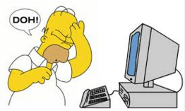
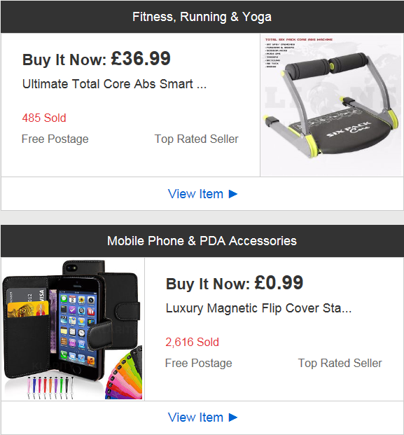
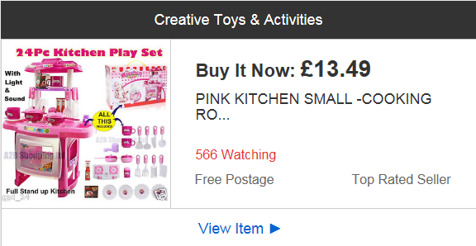
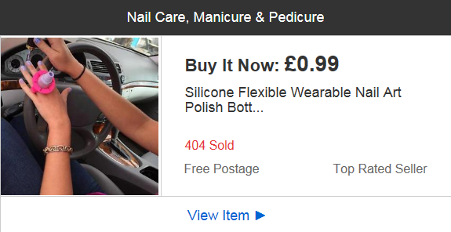
Actual Example: eBay Customer Kidner (CF38) Postcode = Ward Beddau

Slide 25
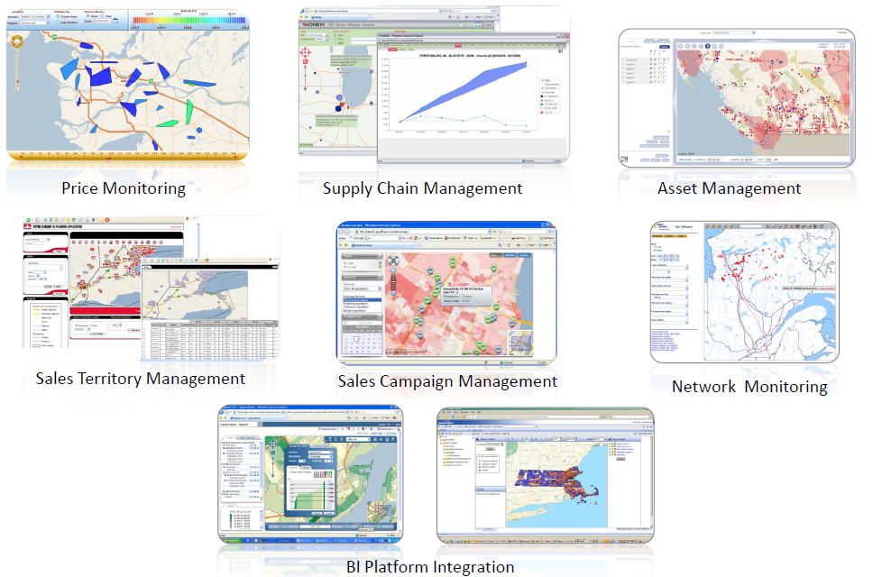
Location Intelligence

Slide 26
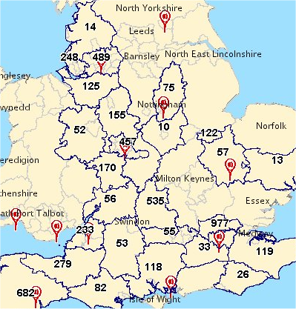
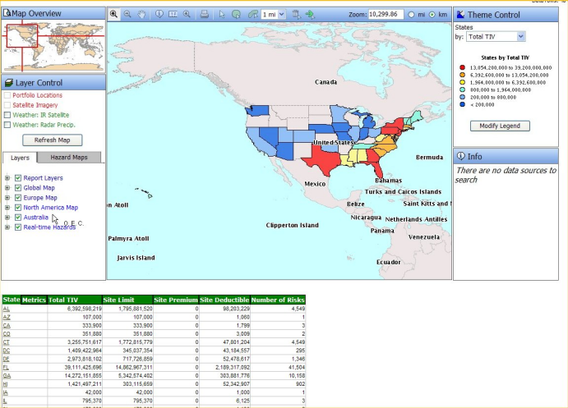
Locational Intelligence: Geographic Visualisation
Where am I selling well ?
Where am I losing customers ?
Where are we at risk ?
How are we performing ?
Where are my customers in relation to my outlets?

Slide 27
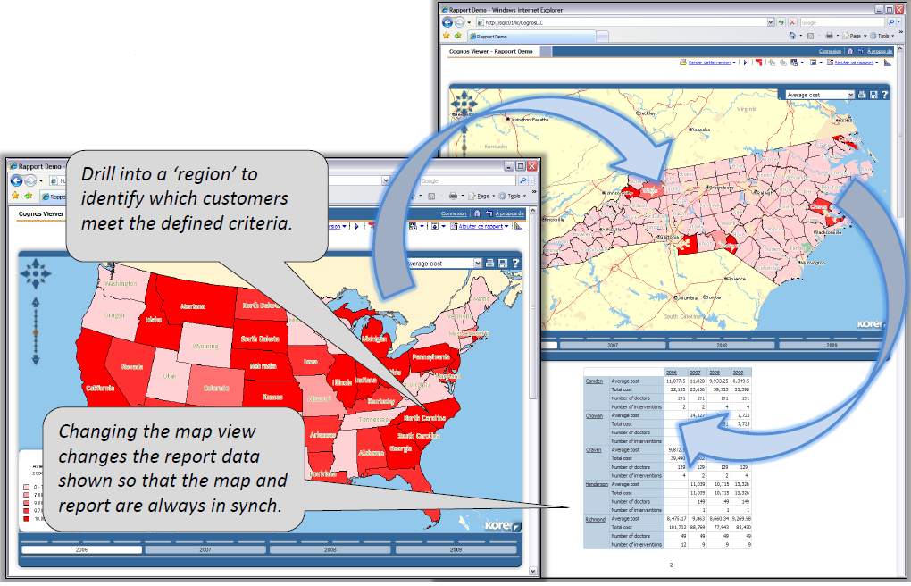
Visualise Demographic,
Customer and
Business Data

Slide 28
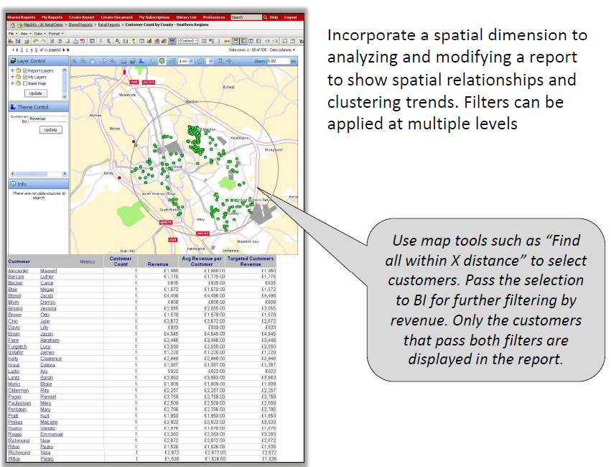

Slide 29
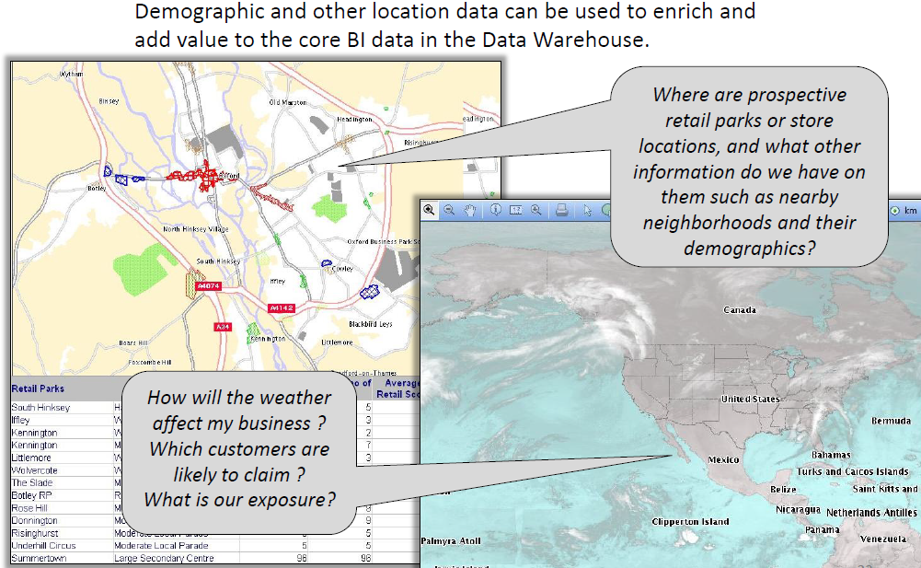

Slide 30
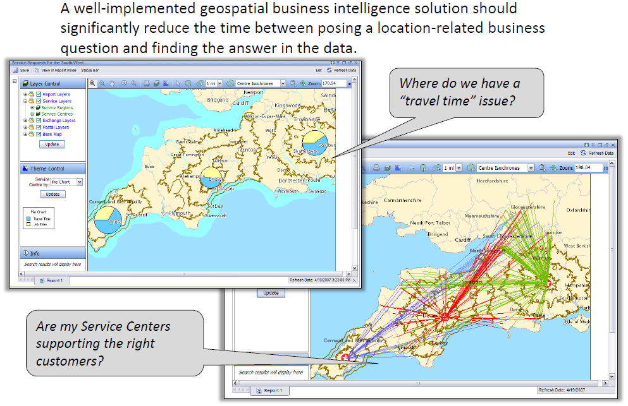

Slide 31
Who are my Customers?
First, categorise customers into segments
What is important for each segment?
Examine behaviour in complementary markets
What 5 new products in your industry have become popular in the last 5 years?
What customer segments are buying these products?
Why do they like these products or services?
Focus on distinctive customer service
Finally, ask who your customers are

Slide 32
How Are My Customers’ Priorities Changing?
What five things do your customers ask for most often?
Are your customers seeking experience, not just product/service?
How will you add value to them?
How has your customer changed in past 5 years, and what will be the change in the next 3?

Slide 33
How Can I Add Value to My Target Customer?
Customers want innovation, value and savings
How can a company provide increasing value for its customers while simultaneously reinventing certain parts of its business?
Rule breakers avoid focusing too much on competition, tend to be creative, and don’t let industry assumptions become a barrier

Slide 34
How Do I Become A Customer’s First Choice?
Every customer contact creates for the customer a moment of mediocrity, a moment of misery, or a moment of ecstasy;
How do your customers experience contact with your firm?
You can be a customer’s first choice if you dazzle them with unexpected service
What incentives do you offer your best customers?
How do customers make decisions about buying your firm’s product or service?
What has your company done to retain customers and deepen customer relationship?

Slide 35
Summary
Understanding our Customers is Essential
Understanding Demographics
Making Sense of all the Data Available to Us
Business Intelligence
Locational Intelligence
Review the statistics. What do they indicate about markets that are ripe for e-commerce?
What e-Commerce sites do you know about that are multilingual? Localised?

